Slide 1


HTML PROJECT Topic:ONLINE-ENTERTAINMENT-HUB
CREATTED BY:
Syed Sardar Valli(12218530)
PEDDALA SRI KRISHNA KARTHIKEYAN REDDY(12222889)
Esha Dey(12222770)

Slide 2



TECHNOLOGY USED:

Slide 3

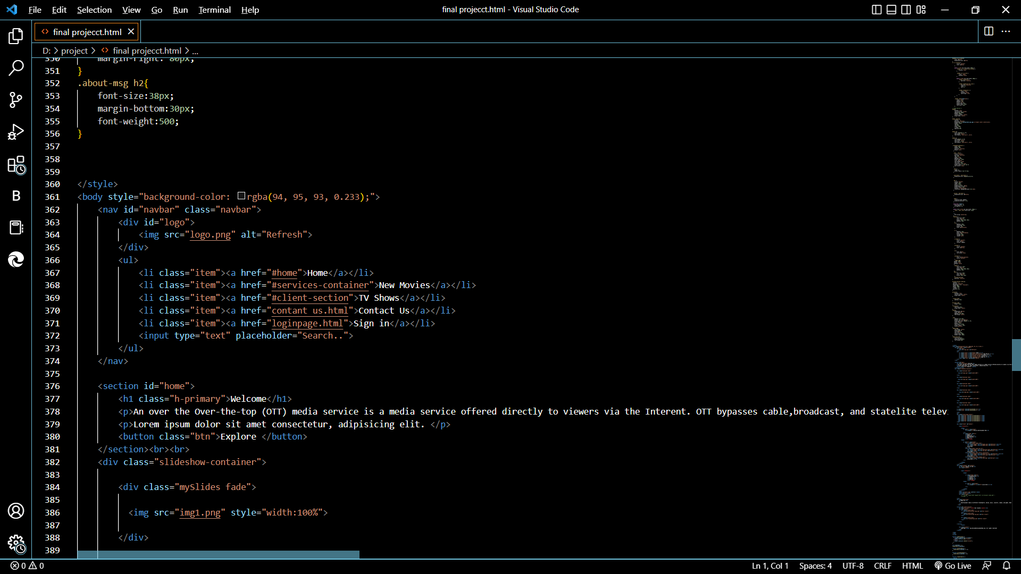

Slide 4


Slide 5
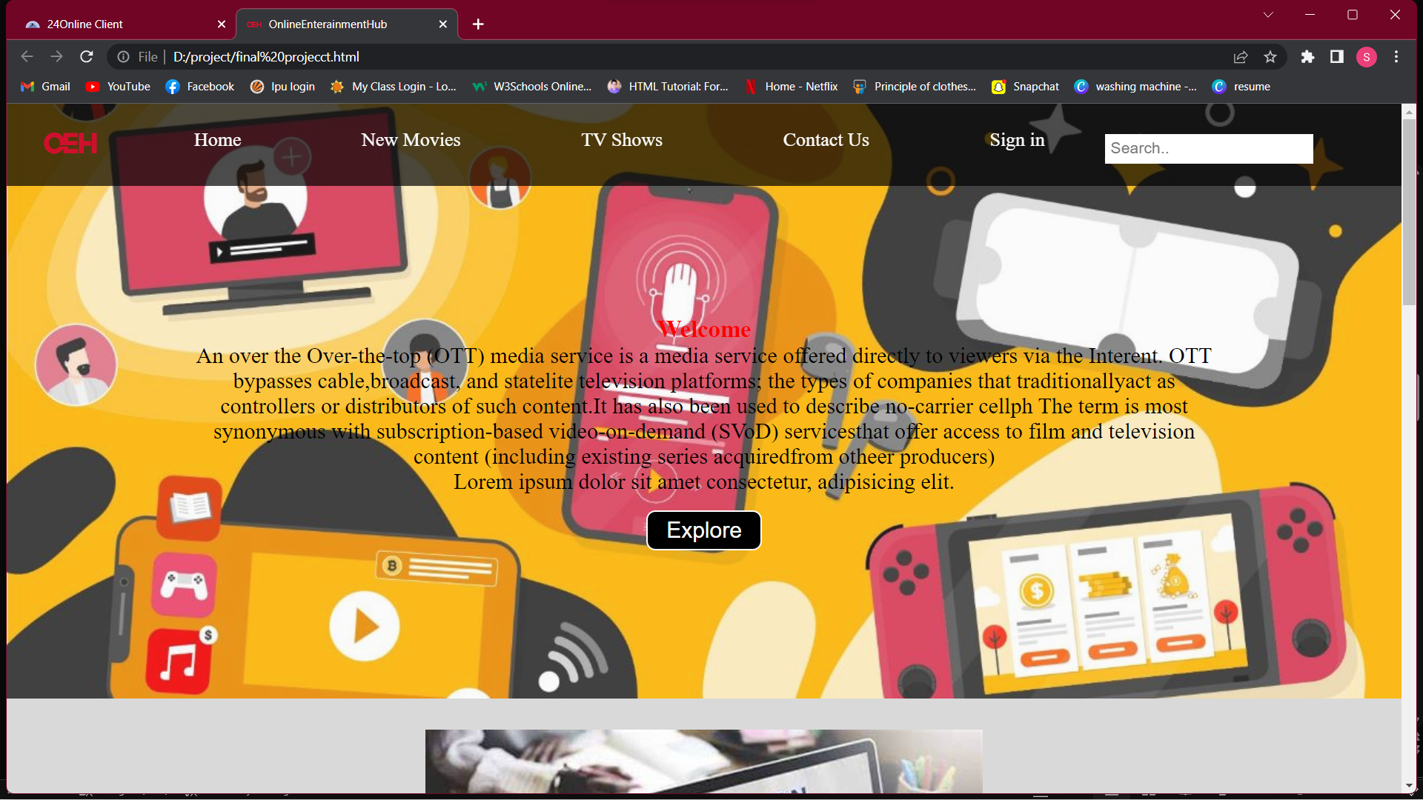

Slide 6
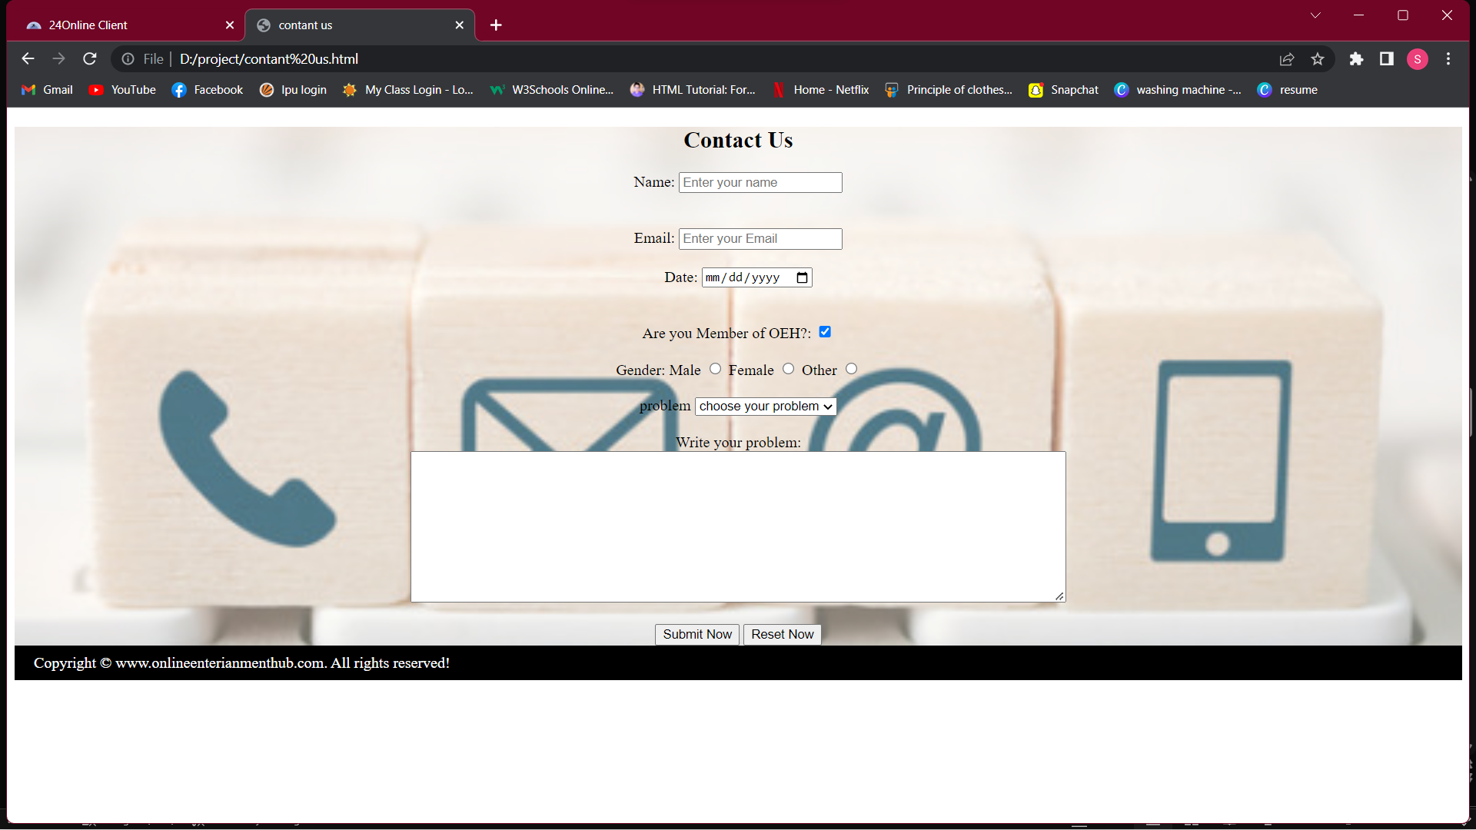

Slide 7

Introduction:
Online Entertainment Hub is online web page which is used to play games,watch movies,reading new,etc.,.In that HTML,CSS,JavaScript is used. Everyone loves entertainment to get rid of all the tensions and stress. There is not a single person who didn’t watch a single film or show. Whether it may be any genre like sci-fi, romance, thriller, action, comedy, or else, the audience is always in search of new dynamic content.In the last few years, Online entertainment platforms took place in smartphones, and entertainment made easy, everywhere as well as affordable too.What made the audience shift on mobile’s tiny screens, laptop screens from TV sets, and huge 70mm theatre screens? Is the entertainment business is changing its attire? Let’s find it out more.The global film industry aka the motion picture industry generates more than $136 billion including box office collections as well as home entertainment such as DVDs, CDs, and TV. Largest film industries like the US and India feed 377,470 and 248,600 people respectively.
Explanation:
Not only in movies,web series people like to play games and read news form online which make people comfort. Another top benefit of using the internet for entertainment is you can better control what children in your home can and can’t see. Programming your router using a free parental control service like OpenDNS will help you set a content filter that suits your family’s browsing protection needs. You can block adult content, video-sharing sites, social networking sites and other ways to keep your kids safe.Programming your router with parental controls should also prevent mobile device access to blocked sites when using the programmed Wi-Fi network, which is great for kids using tablets or grabbing at your phone. If you don’t add parental controls to your router, you can add parental controls directly on your Windows or Mac computer system. Either way, having the option to block certain types of content is a huge asset.
Many traditional television subscribers have cut the cord in the past decade and they’ve used the internet to help them do it. Cable TV service can rack up a decent-sized bill that includes networks you don’t need and is missing some you enjoy. Web-based streaming services like Netflix and Amazon Prime Video provide the flexibility to watch on any Wi-Fi enabled device and they often do so at a fraction of the price of traditional TV service

Slide 8
Online games today are the most popular form of entertainment among teens as well as elders. It is surprising to see a father son duo battling it out on the screen, both furiously tapping away at the keyboard or the joystick. There are a million online games these days, literally. Google the word "online games" and you will know that the above statement is no exaggeration. The numbers are growing. You can play free games any time.
There are different genres of games to suit all age groups and tastes. For the tiny tots, games such as dressing Barbie, Finding Nemo, Tic Tac Toe, color me, Music Panda etc. for those interested in racing, there are more racing options online than in real life. You can choose from bike racing, truck racing or even be a Schumacker and choose a Ferrari. That is the best part of online gaming. The number of online games available online actually give you an option of living a virtual life momentarily. You could be Angelina Jolie and play tomb raider or you could be James Bond and solve a case experiencing the same chutzpah which one comes across in the movies. As long as the line between the real and the virtual world is clearly demarcated, there is no harm in playing your alter ego. You can play free online games by downloading them. These are free downloadable games. This means that no fees are charged for downloading them on to your system and play them whenever you feel like. These can be found on various sites which allow free download. Some of these downloadable games may require additional software to support them. For example, games with extensive graphics and special effects will need a flash player to be installed in the system as well as a shockwave player. These can be directly downloaded from the internet again for free. Some systems have them in built.
There are even computers which are made specially to support all forms of games. These are called multimedia computers. They have all the supporting hardware as well as software to enhance the effect of gaming. If you want to truly enjoy the spirit of online games, it would be advisable to go for this type of a computer. Online games are serious business for some. There are many online gaming contests held everyday where thousands of dollars change hands. These games are gaining as much popularity as what the casinos did when they hit the scene. Special gaming centers have been built keeping in mind the investment opportunities in such a business. The world class gaming centers attract novice and experienced gamers who take online gaming seriously and treat it as a means to earning extra bucks. Be it sword fight, formula one or cricket, there are takers for all the game forms. For those who are looking at online games as a means of taking a short break between work, a short game of Pac man or minesweeper will do wonders to relax yet stimulate you mentally.

Slide 9
We are growing day by day in the field of technology. Technology is involved everywhere, whether using a button to drive an electric fan or making a huge space vehicle. Similarly, the presence of technology is now taking place in reading news and regularly updating. Gone are the times when people usually wait to get news or watch television or read newspapers. The introduction of the Internet has led to the latest breaking news websites that provide a wide variety of information with an issue. Additionally, online readers have many advantages over offline readers.
Less expensive: – Reading online news is less expensive because there is no distribution fee, no printing work which usually makes the newspaper more expensive and the readers have to read more by paying more. If you talk about reading online news, then you can read it using a little bit of your mobile data. It looks accessible as well as less expensive.
Eco-friendly: – In the present scenario, the environmental issue matters a lot. Reading news online is a good step towards saving the environment. Hard copies contain paper, chemical inks that can harm our environment. To use paper, millions of trees are cut in one stroke and the same ink containing chemicals on the paper, which is found in the environment, contaminates it. Instead of reading news from magazines or newspapers, we can read it online, where no paper or chemical-use ink is required
Instant Edit and Update: – Online news gives information about any event immediately. The same takes time for collection, printing time as well as the distribution of material for offline reading, which is considered to be outdated in the time of this new modern world. As such, we can say how important it is to be updated immediately in the modern era and for which we have to depend on online news instead of reading offline news.
Get a large amount of information: – Digital content requires less space to hold a large amount of information. Therefore, by reading online news, you get more types of news available depending on your interest. Here, along with any current news, you can get the information behind it, which will make it easier to understand.

Slide 10
With online classes, you don’t need to move to a different city or commute long distances in order to attend the program of your choice. You can stay where you are and keep your current job while you work toward enhancing your career with an online college or graduate degree (However, some programs require fieldwork experience, which may necessitate relocation.) On the other hand, if you want to become a digital nomad—someone who embraces a location-independent, technology-enabled lifestyle—online education may allow you to do that too. You can watch lectures and complete your coursework wherever you are—whether that’s at home, in a café, or on an exotic beach.
Whether you’re a full-time or part-time online student, the online learning experience allows for a much more flexible schedule. Some elements may be synchronous: You may need to attend live lectures, demonstrations, or discussion sessions. But many elements will be asynchronous, meaning that you can complete them at your own pace, learning at the time of day and in the place that works best for you.When you’re more in control of your schedule, time management goes more smoothly. It’s easier to maintain an active social and family life while earning your college degree or graduate degree. It is possible to have it all: education, professional development, and a vibrant personal life.
Another benefit of online learning and a better school-life balance is that you can develop greater discipline about healthy habits. Not everyone enjoys squeezing in a workout or yoga session at the crack of dawn or right before bed. So if you’re learning from home, you can take a midday jog or online Pilates class. You can even take a power nap, which research has shown can benefit memory and learning.Studying from home can also give you more time to focus on self-care. Whether through self-reflection, meditation, or yoga, practicing self-care can help boost your confidence and emotional intelligence.

Slide 11
GITHUB:
Syed sardar valli-- https://github.com/sardarvali
KRISHNA KARTHIKEYAN REDDY-- https://github.com/Krikare
Esha dey-- https://github.com/esha-dey-22

